Slide 1
Budget Kickoff
February 27, 2018

Slide 2
Questions during the meeting
Budget@finance.nv.gov
Raise your hand
3x5 cards are available for written questions

Slide 3
Morning Agenda
Introduction, Overview & Strategic Plan
Economic & Demographic Update
Budget Cycle Due Dates , Processes & Policy Reminders
Enhancements, Caps & Efficiency Options
Bill Draft Requests
Questions & Answers

Slide 4
Introduction, Overview & the Strategic Planning Process
Mike Willden, Chief of Staff

Slide 5
BUDGET OVERVIEW
Unknowns and Challenges
Roll-ups
Flat Budgeting – 2 X FY19 Cap
Notes:
As planning for the 2019-2021 biennium begins, it is important to recognize it will be one of transition. A new Governor will be elected in November 2018 and will likely bring new priorities and fresh ideas on how the State government should operate. In the meantime, Governor Sandoval intends to draw upon the Strategic Planning Framework to set policy and budget priorities for the upcoming biennium while preserving some flexibility for his successor to put his or her stamp on the final product.

Slide 6
BUDGET OVERVIEW
Enhancements
Must Align With The Governor’s Initiatives
Coordination Among Agencies
Must Be Measurable
Use “Items for Special Consideration” version in NEBS
Notes:
Any enhancement units submitted by agencies for consideration in the upcoming budget cycle will need to align with one or more of the Initiatives identified by the Governor in the Strategic Plan. Agencies must clearly outline how the enhancement will advance the State’s performance relative to the priority and related goal(s). The enhancement narrative must include how the additional investment will incrementally improve annual targets for each applicable existing agency Performance Measure or identify what benchmark will be used for any newly proposed Performance Measure should the enhancement be enacted. If circumstances change or information arises late in the process which would affect the Agency Request Budget, revisions will be considered for inclusion in the final Governor Recommends Budget.

Slide 7
BUDGET OVERVIEW
Efficiency Options
Look For Ways To Do Things Differently And Better Manage Resources
Required To Submit
No fixed amount
Can be an enhancement to create efficiency
Savings must be demonstrable

Slide 8
“Generations to Come” - 2016-2020
Built a framework that covers:
Executive Budget
Bill Draft Requests
Agency Implementation
It is the Governor’s intent to inform:
Agency strategic plans
Next biennial budget
Legislative bill draft requests for 2019
Notes:
Show State strategic plan.
The best budgets link investments to goals and priorities. Under the direction of the Governor’s Office, considerable time and effort was spent developing the long-term strategic plan released in 2016. That document will continue to influence the investment of limited resources to best improve outcomes in each of the defined Core Functions of Government.
The Goals and Objectives identified in the Strategic Planning Framework will guide continued progress toward the State’s long-term success as well as the Governor’s Initiatives for creation of the 2019-2021 budget. Those Goals and Objectives will provide the foundation for any enhancement requests submitted by State agencies as well as a starting point for the new Governor to consider for the final Governor Recommends budget submitted to the 2019 Legislature.

Slide 9
Strategic Framework
Vision – Mission - Values
Strategic Priorities
Core Functions of Government
Mission-driven Goals
Objectives
Budget Activities
Bill Draft Requests
Performance Measures

Slide 10
Where We Are Headed
Vision – “Nevada’s best days are yet to come”
Mission – To create a new Nevada while honoring and enhancing 150 years of success
Values
Leadership
Action
Collaboration
Inclusiveness
Integrity
Optimism
Service

Slide 11
How the Framework is Organized
Strategic Priority – one of the four organizing principals established by the Governor
1. Core Function of Government – statutory responsibility of State Government
1.1. Goal – broad statements of the desired result from State Agency action
1.1.1. Objective – measurable indicators of progress towards goal

Slide 12
Strategic Framework Example
Strategic Priority – Vibrant and Sustainable Economy
1. Business Development and Services
1.1. Lead the nation in high-quality job creation
1.1.1. By 2020, the job growth rate in Nevada will exceed the national average

Slide 13
Priorities and Core Functions

Slide 14
Priorities and Core Functions
EDUCATED & HEALTHY CITIZENRY
Transforming Education
Promoting Healthy, Vibrant Communities
EFFICIENT & RESPONSIVE STATE GOVT
Government Efficiency & Innovation
SAFE & LIVABLE COMMUNITIES
Infrastructure, Energy & Environment
Improving Safety, Security & Justice
VIBRANT & SUSTAINABLE ECONOMY
Expanding Economic Opportunity & Growing a Skilled Workforce

Slide 15
Strategic Planning Priorities
Governor is asking agencies to consider the following challenges to make state government more effective and efficient:
What activities do you perform you would stop if you could? What results could be obtained by reprioritizing those resources?
What new initiatives would you propose? What results would they achieve? How would success be measured?
What low-cost or no-cost policy or operational ideas would you propose?

Slide 16
Economic Overview
Susanna Powers
Executive Branch Economist
spowers@finance.nv.gov

Slide 17
Nevada Economic Forecast
BKO 2010: Stormy
Economy still in freefall
BKO 2012: Partly Cloudy
Signs that worst behind us
BKO 2014: Mostly Sunny
Recovery under way & strengthening
BKO 2016: Mostly Sunny
Economy strengthening & challenges remain
BKO 2018: Sunny
Steady recovery & room to improve

Slide 18
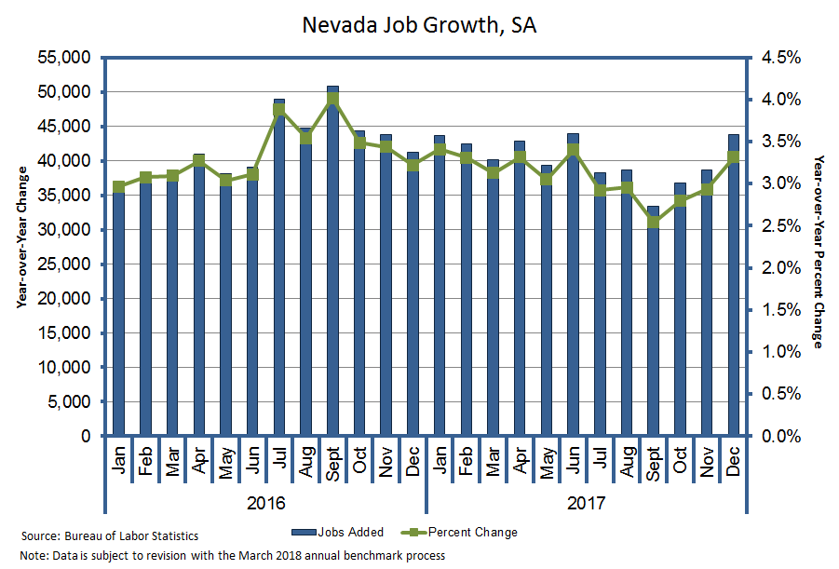
Last year, about 40,000 jobs were created (a 3.1% growth rate).
Job growth is now on a more sustainable path compared to the pre-recession boom period.

Slide 19
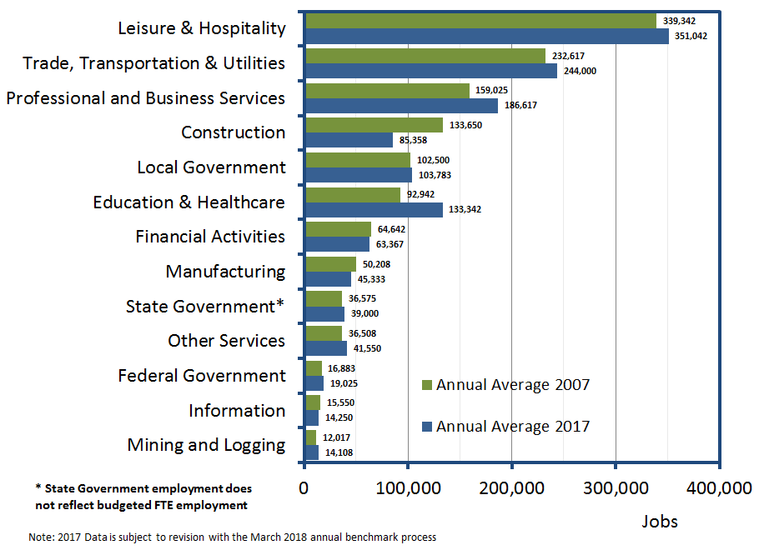
All industrial sectors are above or near their pre-recession level employment except construction.

Slide 20
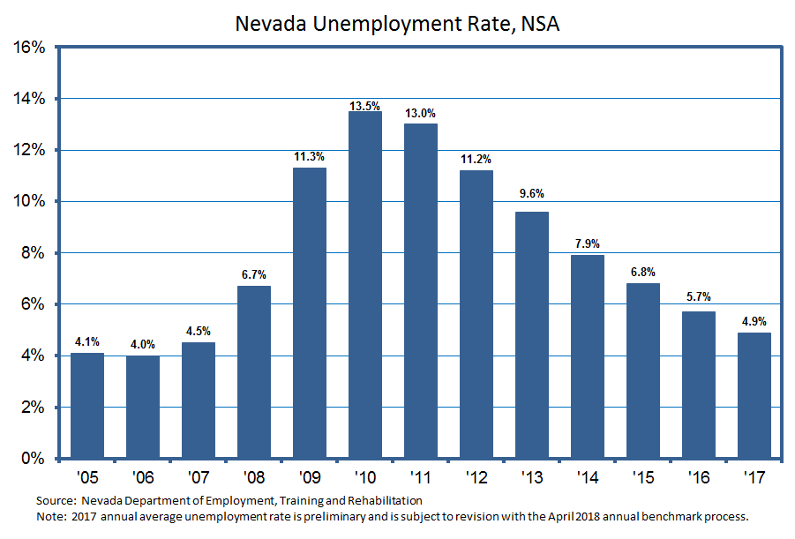
Last year, the unemployment rate declined to 4.9%, the lowest rate since 2007 and 0.5 percentage point above the national rate.
The jobless rate is likely to trend down closer to what it was before the recession heading into the 2019-2021 biennium.

Slide 21
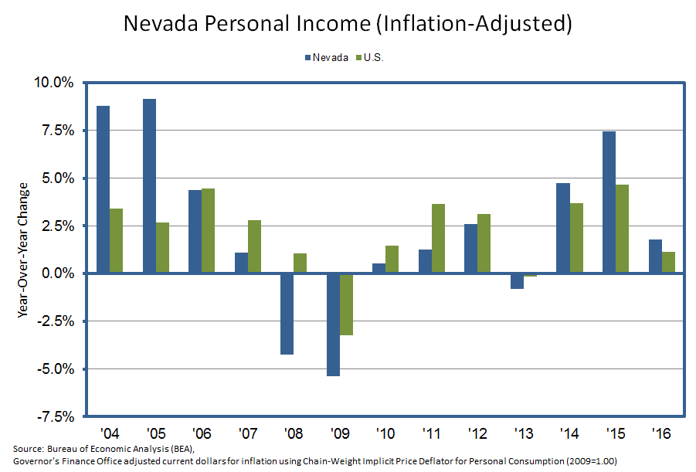
In 2016, Nevada’s personal income grew by 1.8% , exceeding that for the U.S. at 1.1%.
In 2017, Nevada is on pace to exceed U.S. as well.

Slide 22
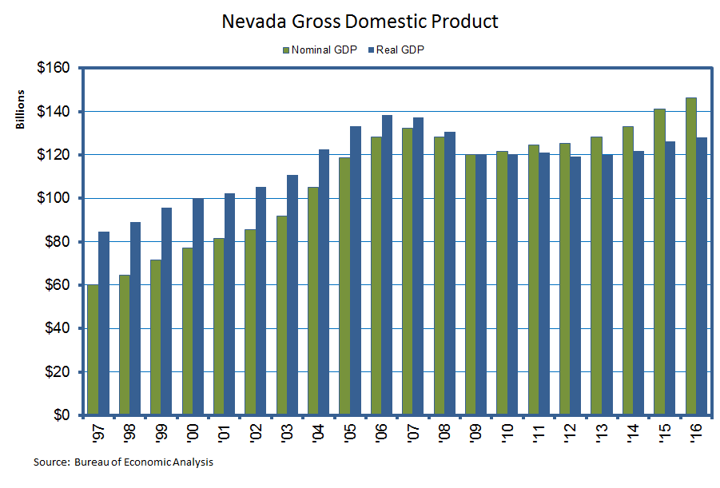
After adjusting for inflation, Nevada achieved real GDP growth in 2016.

Slide 23
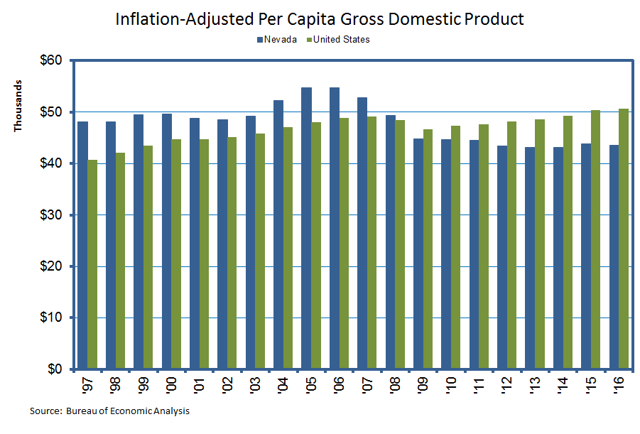
On a per capita basis, Nevada’s real economic output lags behind that of the U.S.

Slide 24
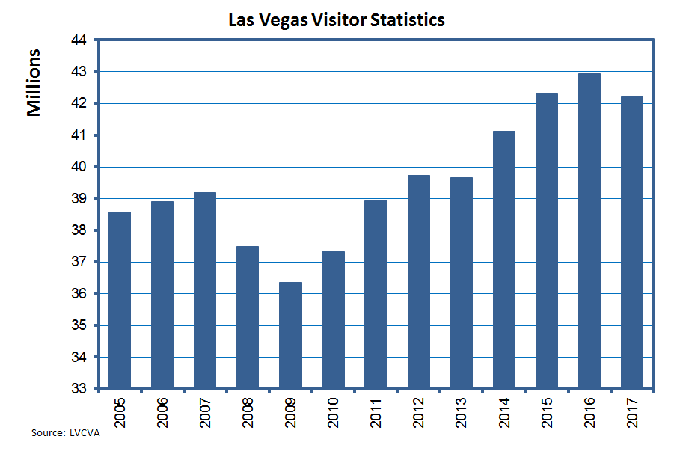
Las Vegas visitation is holding steady.

Slide 25
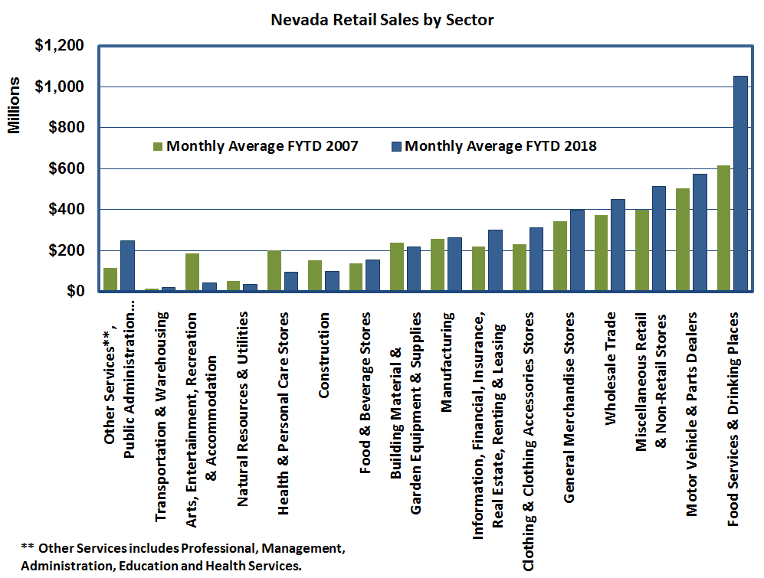
Bars and restaurant are the biggest spending category.

Slide 26
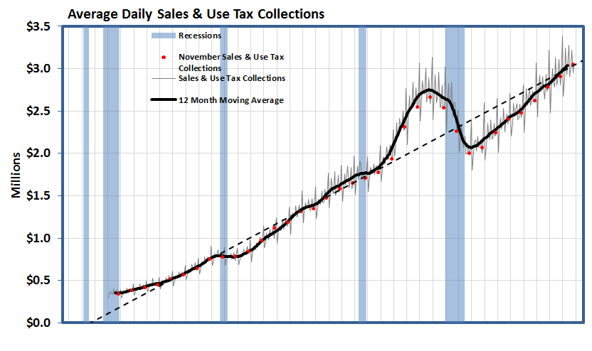
Average daily sales and use tax collections slowly returning to a long-term trend.

Slide 27
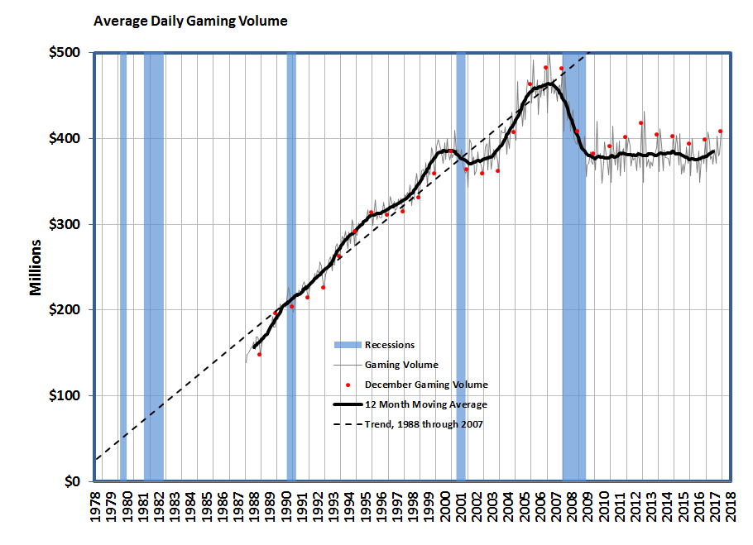
Average daily gaming volume has been flat since the economic recovery began but is finally seeing a slight uptick.

Slide 28
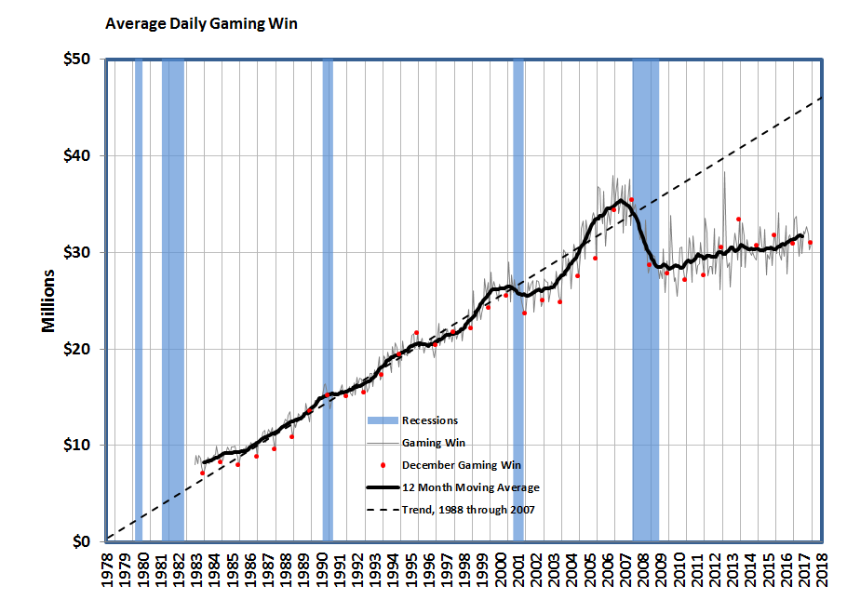
Average daily gaming win has been trending up.

Slide 29
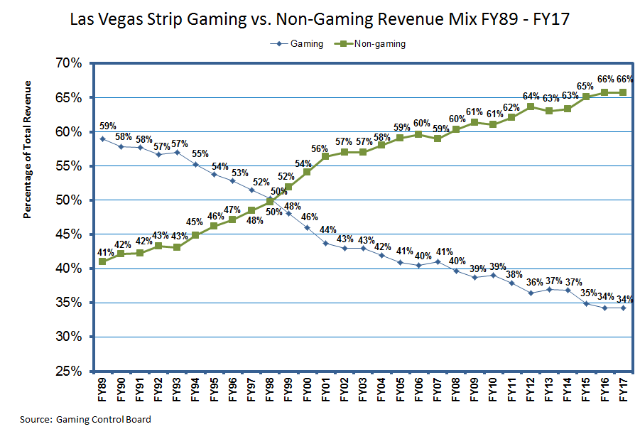
Non-gaming revenue comprises 66% of Las Vegas’ total revenue mix as a result of a market shift in consumer gaming habits.

Slide 30
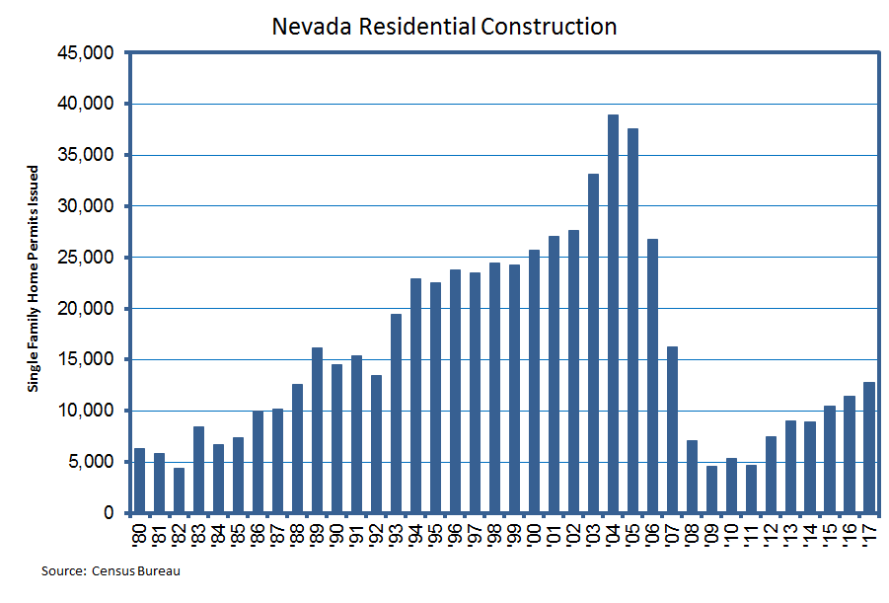
Home permits are trailing in the level we saw in the late 1980s.

Slide 31
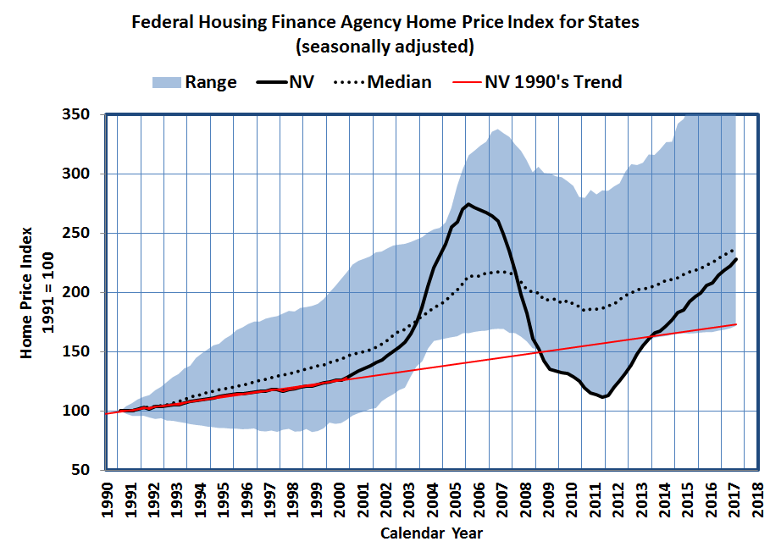
In the third quarter of 2017, house prices rose 9.6 percent in Nevada, the fifth strongest gain in the nation.

Slide 32
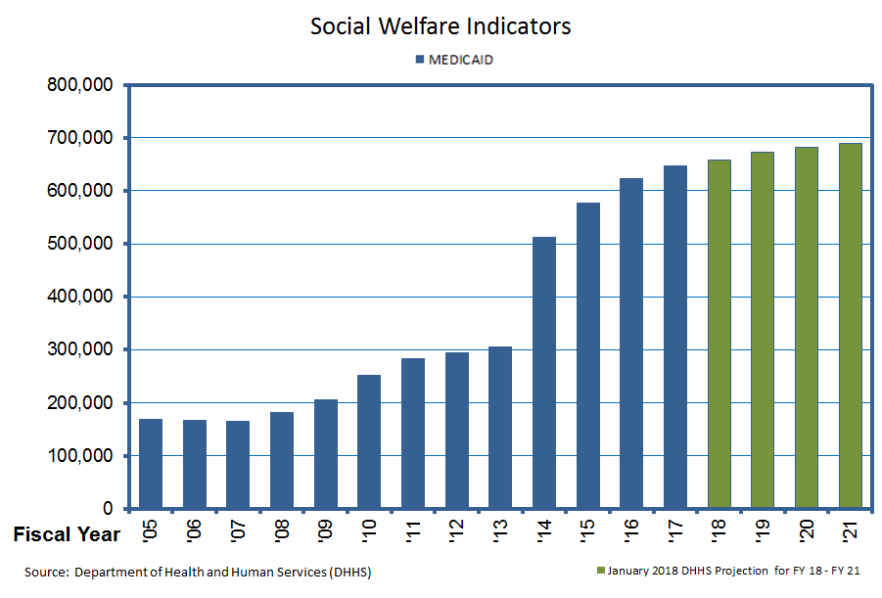
Enrollment in Medicaid is projected to increase.

Slide 33
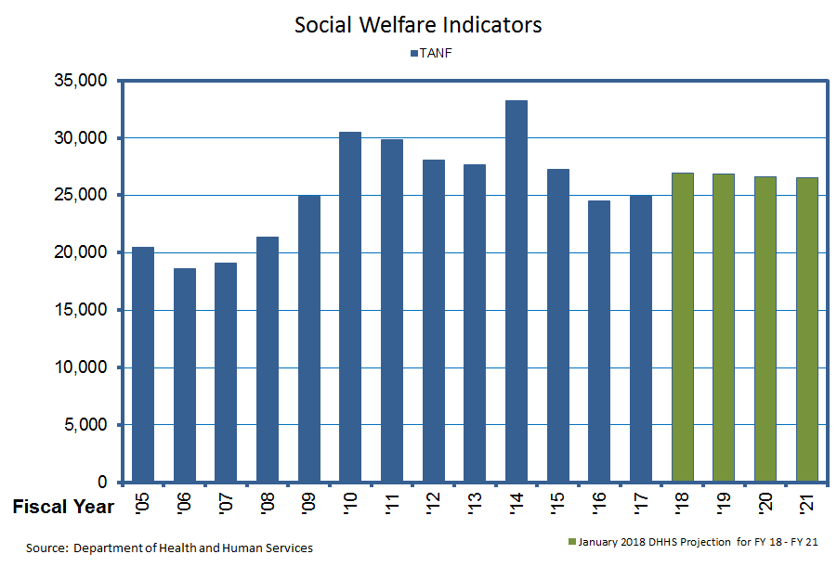
Despite improvements in economic conditions, need for temporary assistance remains relatively high.

Slide 34
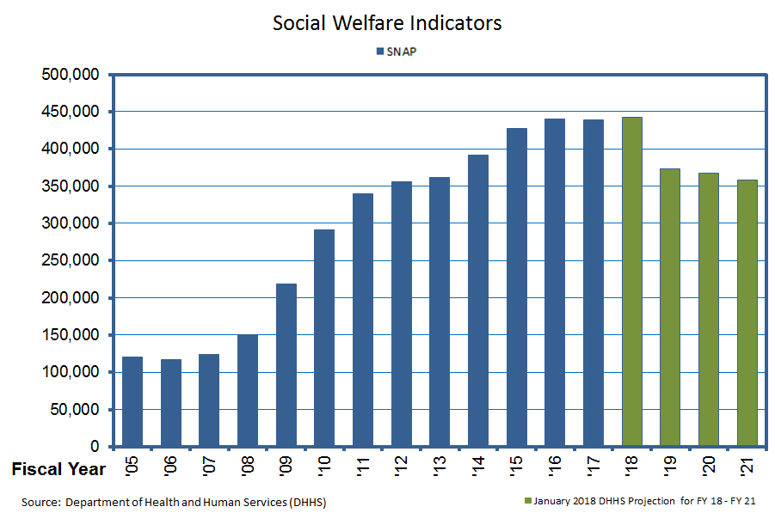
The Exemption Waiver for Able Bodied Adults without Dependents expired, reducing the number of people eligible for supplemental nutrition assistance in the next biennium.

Slide 35
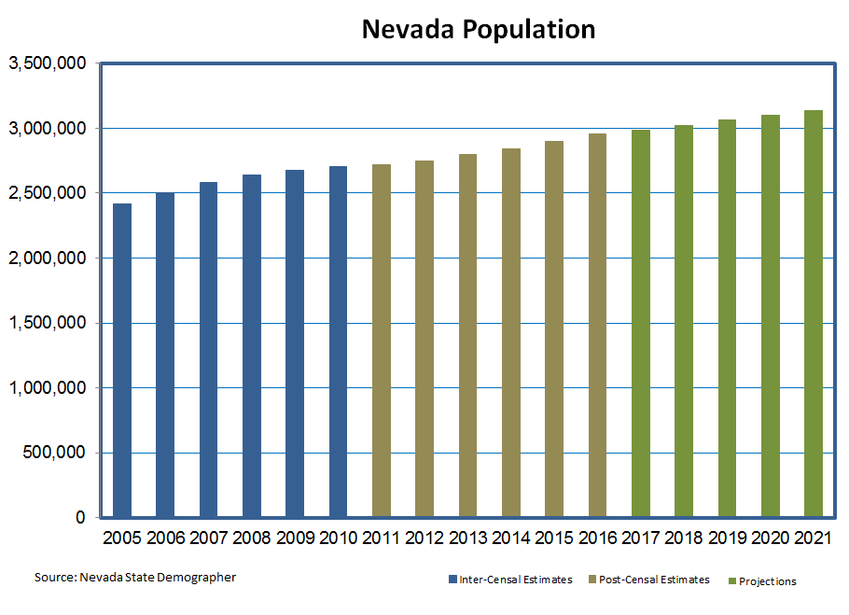
Nevada’s population is estimated to reach 3.1 million by the end of the 2019-2021 biennium.

Slide 36
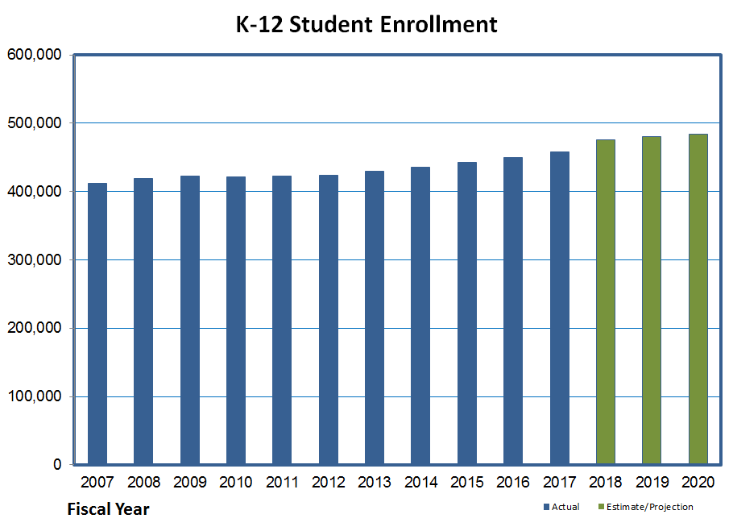
Since 2007, K-12 enrollment has increased about 11%.

Slide 37
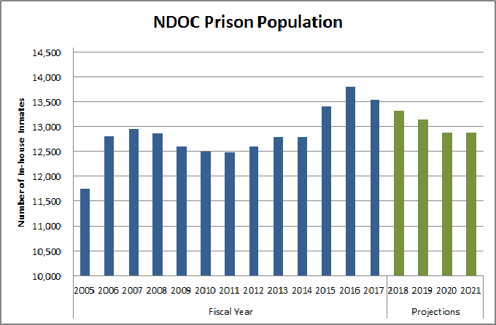
Even though the state population is projected to increase, Nevada Department of Corrections (NDOC) is expecting a reduction in prison population due to a reformed approach that maximizes minimum custody and focuses on reducing recidivism.

Slide 38
Revenue Outlook

Slide 39
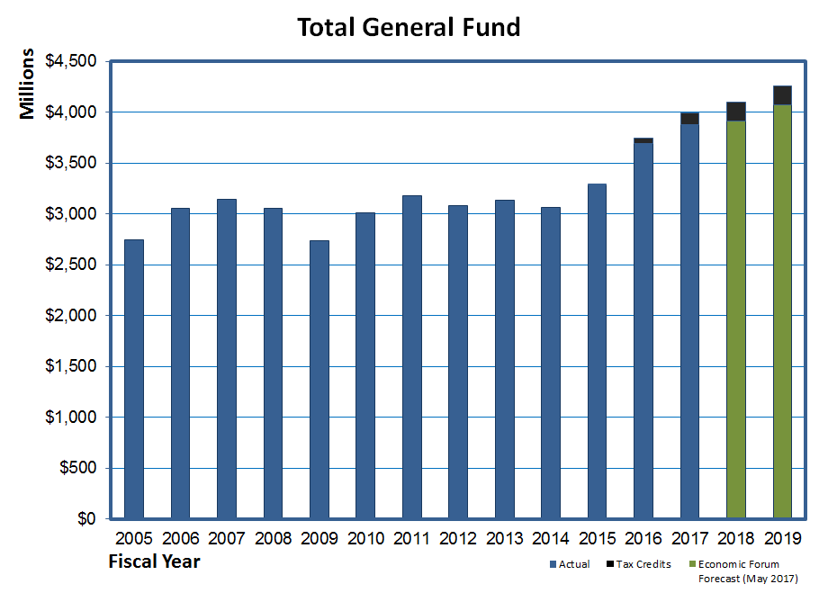
Fiscal 2018 year-to-date, net revenue tracking $17.2 million, or 1.2%, ahead of forecast. A total of $92.3 million in tax credits taken so far against various taxes.

Slide 40
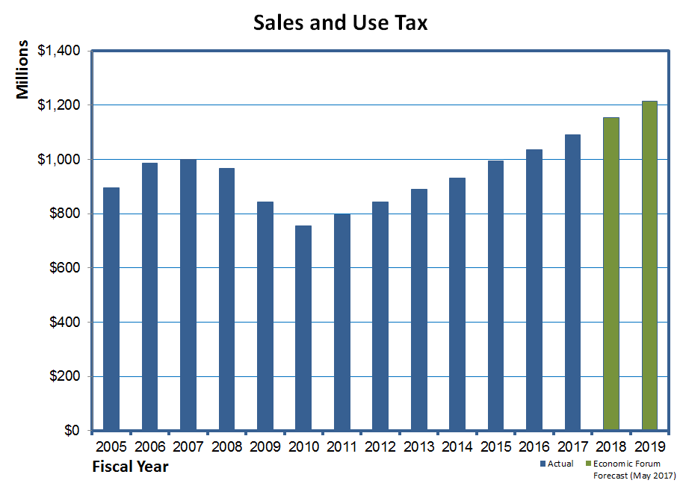
Sales tax revenue has been softer than expected. Collections are 1.4%, or $6.7 million, below the fiscal year-to-date forecast.

Slide 41
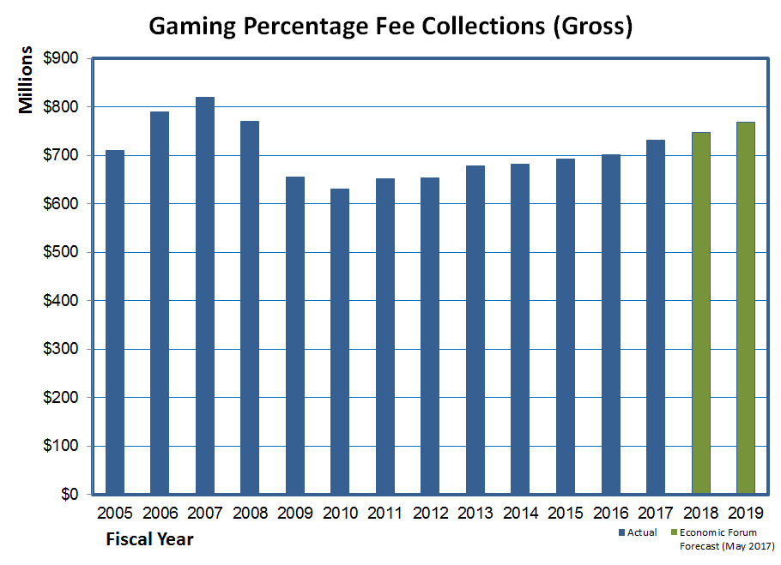
Through the January collection period, gross (before tax credits) gaming collections are 2.9%, or $11.7 million, above the forecast.

Slide 42
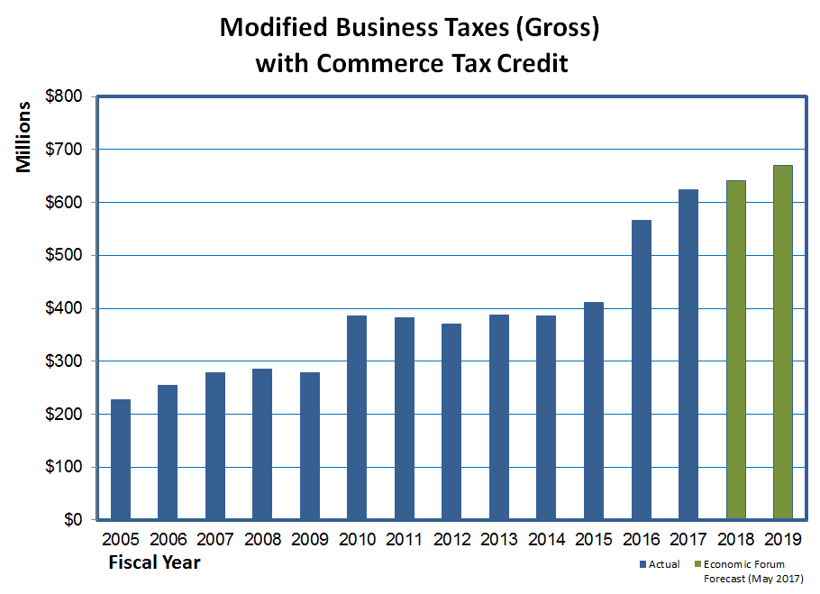
Gross collections after one quarter are 2.4%, or $3.7 million, below the forecast.

Slide 43
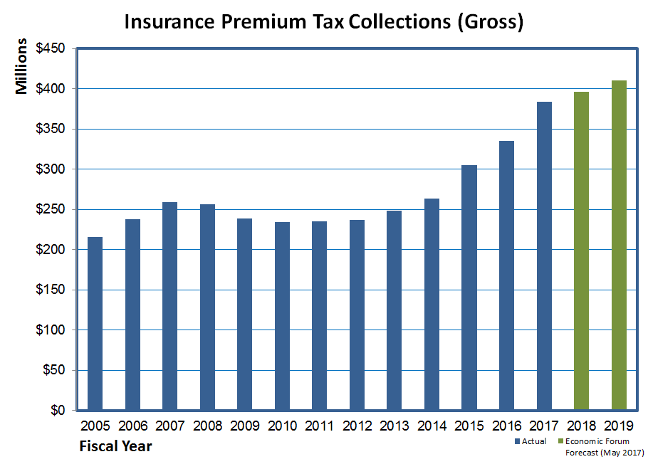
Gross collections after one quarter are 6.8%, or $6.8 million, ahead of forecast.

Slide 44
Conclusions
Nevada’s economy strengthening
Outlook for General Fund revenue for the current biennium is positive
Potential risks to national economic outlook
Budget deficits, inflation, higher interest rates
Trade relations
Geopolitical risks

Slide 45
Budget Cycle & Due Dates
Jim Wells
Director

Slide 46
Budget Cycle
Agency Request
Due 5:00PM Friday August 31, 2018
Governor Recommends
Budget Message and Summary
Line Item Detail
Economic Development Incentives
Recommended Legislation
Legislatively Approved
Session starts February 4, 2019
Session ends June 3, 2019
Resources on the Budget Division website (www.budget.nv.gov)

Slide 47
Key Dates
CIPs due – 4/2
Presentations 8/22-23
TINs due – 4/6
Non-budgetary BDR Concepts – 4/13
Approve by 5/11
Final Non-budgetary BDRs – 6/8
Class Compensation Plan Changes – 7/1
Complete Adjusted Base – 11/09
Complete Governor Recommends – early January 2019
Notes:
CIPs > $100k or meeting the definition of a structural or statewide project must submit an application by 4/4. CIPs >$10M are funded in 2 phases – Design/Planning in the first biennium and construction in a subsequent biennium depending on funding availability. After the August presentations, the SPWB submits recommendations to the Governor by October 1 after which the Governor will develop final CIP recommendations. Additional information regarding CIPs can be obtained from the State Public Works Division.
New TINs are due to EITS by 4/14. They will be returned by 6/27 and forwarded to the IT Strategic Planning Committee made up of key state staff members for review. The Strategic Planning Committee will submit its recommendations to the Budget Division by 7/25.

Slide 48
Overview of Budgeting Processes and Policy Reminders
Jim Wells
Director

Slide 49
Budget Processes
Building the Budget
Positions
Revenues
Federal Grants
Priorities & Performance Based Budgets
Enhancement Requests and Efficiency Options
Required Forms
Technology Investments
Notes:
Very few changes in the budget instructions. Most of what you will see are reminders of items changed during the last budget building cycle.
Budgeting for New and Vacant Positions
Database of State Fees
Federal Grant Maintenance Of Effort/Match documentation
Budgeting for Grant carryforward amounts
Updating previously approved Technology Information Requests
Priorities and Performance Based Budgets and mapping
Budget Submission Certification Letter and Organization Charts

Slide 50
Building the Budget
Agency budgets must:
Align with Governor’s Strategic Framework
Reconcile positions, revenues and expenditures
Be consistent with legislation passed in 2017
Use FY 2018 actuals for the Base Budget
Be adjusted for one-time, annualized and discontinued costs
Be submitted in complete form

Slide 51
Building the Budget
Agency budgets should:
Not include agency-specific inflation without adequate justification
Include caseload adjustments as a “M” unit only with prior approval
Document and justify adjustments related to federal mandates, court orders and consent decrees
Reconcile transfer in/out decision units and other “pitcher/catcher” type items
Notes:
Caseload not preapproved may be requested as an enhancement as long as it follows the framework for an enhancement request – new method for breaking out caseloads incurred during current biennium versus caseload increases for upcoming biennium – to be discussed this afternoon.
Agencies should also contact their assigned analyst regarding supplemental appropriations as soon as possible to explore available options

Slide 52
Building the Budget
Agency budgets should:
Include justification for any requested Supplemental Appropriations
Identify and include one-time projects, including multi-biennia requests where appropriate
Include replacement equipment in accordance with an approved schedule
Notes:
Caseload not preapproved may be requested as an enhancement as long as it follows the framework for an enhancement request
Agencies should contact their assigned analyst regarding supplemental appropriations as soon as possible to explore available options

Slide 53
Positions
Agencies must:
Confirm the accuracy of the positions in their budget by PCN before 7/1
Notify their assigned Budget Analyst of errors
Eliminate expired or non-permanent positions
Confirm the accuracy of the incumbents as of the budget request submission
Include on-going seasonal and intermittent positions to the extent funding is available
Notes:
It is critical to reflect accurate position information in the budget submittal request and to provide documentation and justification in support of the proposed staffing levels. The position reconciliation process ensures base positions and associated information in NEBS accurately reflects the legislatively approved positions as amended by actions during the interim. Positions which are being eliminated as part of the Agency Request Budget must still be accounted for in the base position reconciliation and removed in a separate decision unit.

Slide 54
Positions
New permanent positions:
Engage with DHRM on classification
Include NPD-19 for each position
Identify conditions and responsibilities
How the position advances the agency’s mission
How it impacts existing personnel
Include associated costs
Default start date is October 1 of the first year
Notes:
If the requested start date is other than October 1, the agency must provide an explanation and the need for a different start date

Slide 55
Positions
Vacant positions:
Justify retention of 12+ month vacancies
Budget new or vacant positions to hire at no greater than step:
4 for positions in grades 30 and below
7 for positions between grades 31 and 38
10 for positions in grades 39 and higher
Notes:
Last session, we incorporated some flexibility in budgeting for new or vacant positions recognizing that agencies do not always fill positions at step 1 on the pay scale as higher level positions are generally promotions which are brought in at higher steps or outside hires where the State needs to compete with higher salaries.
This flexibility is voluntary and positions may be budgeted at any step below the maximum steps identified. Agencies must stay within their budget caps even if they are using accelerated steps for budgeting purposes.
Further, this does not guarantee the agency can hire at the budgeted steps; you must still go through the current NPD-4 process to hire at the accelerated step.

Slide 56
Positions
Single Reclassifications
Reorganizations
Compensation Plan Adjustments due 7/1
Reclassification of or raises for series of positions
FTE Costs and Assessments
Vacancy Savings
Overtime/Pay Differentials
Notes:
Reclass – must be based on significant changes in the type, difficulty or responsibility of work performed and include documentation (completed NPD-19 for new class) stating conditions necessitating the reclass.
Reorganization - transfer of personnel from one division to another – evaluated for potential organizational efficiencies, cost savings or increases, impacts to customers or quality of service, and issues/ challenges associated with implementation. Consult with Budget Analyst prior to including in agency request. Any merger/deconsolidation must fit w/i Gov’s strategic priorities and be approved by Gov’s Office.
Compensation plan adjs (increase Social Worker classes by one grade) must be submitted to the Budget Division along with justification supporting the request, by 7/1/16 . Approved changes will be included with Gov Rec Budget as a separate enhancement. No guarantee a proposal will be approved.
FTE - health ins premiums s/b charged for both years even if incumbent has opted out of PEBP. AGCAP and SWCAP will be updated for actuals to be used in Gov Rec by 8/1
Vac Savings - calculated for budgets funded in whole or in part by GF or HF, incl Int Svc funds based on historical vacancy information; adjusted for starting dates other than 7/1 and applied to all positions, including new. Agencies may propose an alternative plan as long as net effect generates budget savings. If agency believes V/S creates an undue hardship, it must provide documentation of unique/special circumstances for a lower vacancy rate, including positional capacity and potential alternatives. Discuss options early.
In general, O/T & Pay diff s/b removed in Adj Base.

Slide 57
Revenues
In general, must cover requested expenditures; never used to balance budget
Appropriations
Transfers
Must be reconciled against transfer expenses
Reserves
Generally are non-recurring revenue source
Notes:
Appropriations – Discussed earlier, GF revenues are projected at statewide level by the Econ Forum and HF revenues are projected at statewide level by DMV in consultation with Budget Division. Both are balanced to expenditures during the Gov Rec phase. Must be budgeted in accordance with Agency Request Limit discussed later and cannot cross biennia without specific legislative approval; generally no beginning or ending appropriation balance in a B/A.
Transfers – Pitchers sending a transfer and catchers receiving it must insure the transfers balance. Can include sub-grants of federal funds from other agencies. Receiving agency must be able to maintain federal identity of revenues and associated expenditures for federal grant reporting. Should not be used when an agency contracts for services with another agency or for enterprise type payments – in those cases, appropriate revenue and expense coding should be used. Any Transfer from IFC revenue or one-shot appropriations from prior session must be eliminated in Adj Base. Associated expenditures must be either eliminated or paid with another funding source. Transfers can be used for internal cost allocation or indirect cost plans.
Reserves - programs supported by other revenues must retain enough ending fund balance to meet cash flow and contingency needs and accommodate any statewide increases in salaries, benefits and assessments in Gov Rec Budget. Only be used to cover unanticipated expenditures, one-time expenditures, economic downturns impacts and gaps in cash flow due to timing. Should be limited to between 30 and 60 days of operating expenditures depending on volatility. Excess reserves may indicate the need for a revenue reduction.

Slide 58
Other Revenues
Includes licenses, fees, fines, loan repayments, charges for services or other revenues not deposited into the General Fund for use in the appropriations process.
Must submit detail on any fee established, increased or decreased in the Agency Request
Fee Database
Notes:
In order to understand the entire universe of the funding of state government, the Budget Division created the statewide fee database. Agencies have provided information on every fee they administer and deposit into their budget accounts, including information about the statutory authority for the fee as well as the amount collected. We now have three fiscal years worth of data on state fees which should be used to project fee revenues for the upcoming biennium. The Budget Division will be reviewing the fee database for the reasonableness of fee projections, and significant changes need to be discussed and documented in the Agency Request budget submission.

Slide 59
Federal Revenues
Only includes revenue directly from federal government
Report separately by grant award
Recurring grants should be included in budget
Should be budgeted at NOGA + Carryforward
Not subject to budget caps
Must adhere to statewide cost decisions
Notes:
Fed rev should only include receipts generated and collected directly from the fed govt. Fed funds recd from another agency s/b shown as “Transfer In” revenue.
S/ not be consolidated into 1 line but reported separately in detail by grant award, including the ident of source (e.g. federal agency), grant name, rev acct code and amt.
Recurring federal grants should be included in the Agency Request Budget, including expenditures and positions associated with those grants and include any projected federal cost recovery under the agency’s approved indirect cost plan.
Base federal revenues must be adjusted to cover base salary costs for positions funded by the grant with other adjustments in adj base.
Federal revenue in Agency Req should present the most accurate projections of federal funding available for the biennium. Federal funds are often available on fed FY and may be available for multiple state/federal FYs. Documentation, including the Notice of Grant Award , must be provided to substantiate increase/decrease to the grant award. Agencies should provide detailed calculations projecting the c/f of unspent authorizations in order to substantiate projected fed rev in the Ag Req above/below the projected grant award for each FY, including a recon to proj grant award amount.
Most fed funds are on a reimbursement basis - no beginning or ending bal; exceptions.

Slide 60
Federal Grants
Matching Requirements documentation
Grant Name
CFDA number
Funding by state FY for term of the grant:
Grant amount, and
match fund requirements
Source of match funds
Appropriation, third-party, in-kind, etc.
Impact of not appropriating the match
Notes:
The fed govt provides significant funds to the State for svcs to our citizens. For certain fed grants, the State must provide a %age of the total program cost, known as a Match Requirement. In some instances, agencies obtain the Match third parties. Agencies must document Match Requirements for federal oper/capital grants including the following as part of their budget submittal:
Grant Name and Fed Catalog of Federal Domestic Assistance (CFDA) #;
Grant amt awarded and match funds required by state FY for term of grant;
Source of match funds (appropriations, third party, in-kind, etc); and
The impact of not appropriating the match requirement
Budget Division staff spent a significant amount of time documenting match requirements for state agencies after the 2017 legislative session ended. There is a new Match Form that needs to be submitted for each grant, even if it is to document there is no match requirement for that particular grant. What we found during the process was that the NOGA was not always correct.

Slide 61
Federal Grants
Maintenance of Effort requirements
Include assumptions and calculations to meet required MOE levels for current and upcoming biennia
Indirect Cost/Cost Allocation Plans
Include federal authorization document showing approved rate
Reconcile “pitchers” and “catchers”
Notes:
In addition to or in place of Match Requirements, some federal grants require recipients to maintain their level of state and/or local expenditures, known as the MOE requirement. If a recipient fails to meet the required level of financial commitment, the federal government may rescind funds promised to the state. Agencies must maintain documentation necessary to show the federal government the State is complying with the required level of financial commitment. Budget Division staff also documented MOE requirements for state agencies in the interim. There is a new MOE Form that needs to be submitted for each grant, even if it is to document there is no requirement for that particular grant. Agencies must include assumptions/calculations for meeting required MOE levels for current/upcoming biennium in their budget submittal. Since state and fed FYs are not aligned, MOE calcs can change and agencies may be required to update MOE documentation, assumptions and calcs.
Used to allocate central costs within their department and result in amounts being transferred between budget accounts to cover costs in the receiving budget account such as the costs of a centralized accounting unit or a Director’s Office. IDC plans must be approved by a Federal Cognizant Agency and agencies must include a copy of their federal authorization document which includes the approved rate with their budget request or when received.
Agencies must insure costs incurred in receiving budget are covered by revenues derived from contributing budgets and include allocation methodology, assumptions and calcs. Maint/Enhance in the receiving budget must have corresponding dec units in contributing budgets. CAPs should not be used to bill other agencies for svcs.

Slide 62
Priorities & Performance Based Budgeting
Strategic planning framework
Mission Driven Goals
Objectives
Priorities
Notes:
Rationale for a performance based budgeting methodology is to identify the services the state provides and to measure the effectiveness and efficiency of delivering the outcomes. Put simply, the goal of performance budgeting is to answer the question “Are we getting what we need in exchange for the resources we are expending to get it?” We heard earlier about the strategic framework and how the budget, policy and strategic planning processes are interwoven.

Slide 63
Fund Mapping
Line item Expenditure to revenue is the same
Map revenues to pre-defined Activities
Mapping of activities to Mission Driven Goals and Core Functions is pre-determined
Notes:
As required in the past, agencies are required to map line item expenditures in each budget account to the revenue source used to pay for those expenditures. The functionality for mapping expenditures to revenues by position, category and object code either as a percentage or fixed amount has not significantly changed.
After mapping expenditures to revenues, agencies will map the individual revenues to one or more of the predefined Activities based on the approximate percentage of the revenue expended for that activity. The mapping of Activities to Mission Driven Goals and Core Functions will be done automatically based on a predetermined structure allowing the Budget Division to generate reports which roll-up expenditures and revenues to the Activity, Mission Driven Goal and Core Function levels providing an alternative view of the State’s budget for the public to see where resources are directed. This has not changed from what was introduced last biennium. If agencies need to revise their mapping or add a new activity, they should contact their Budget Officer.

Slide 64
Performance Measures
Should be:
Logically and directly related to the Activity they are purported to measure
Incorporate significant aspects of the operations of the agency
Responsive to changes in levels of performance
When possible, tied to data already reported internally or externally
Notes:
Performance measurement facilitates accountability and provides an opportunity to identify programs that work and those in need of improvement or elimination. They are intended to answer the question: “Are we making progress toward achieving our targeted results?” A credible answer must be backed by evidence in the form of Performance Measures which provide data on how the program is operated, how well the customers are served and whether the program is achieving its intended outcome. Analyzing the performance of an Activity is important to assess whether the investment has proven worth the cost and whether performance can be improved or a different strategy could better contribute toward achieving the desired statewide result. Agencies should use performance data to target low-performing programs for elimination and to redirect funding to programs with a higher return on the State’s investment.
Such as that provided to a federal agency in support of a grant.

Slide 65
Performance Measures
Three main types:
Output/workload - “How much did we do?”
Efficiency – “How well did we do it?” or “Are we doing things right?”
Effectiveness “Is anyone better off?” or “Are we doing the right things?”
No right or wrong number of measures
Narrative description option
Notes:
Continue to be at the Activity level and not all budget accounts will have separate indicators.
While each Activity must have at least one Performance Measure, there is no right or wrong number of Performance Measures as long as the measures provide the full story of the operations and value of the Activity . An agency may also have several Activities targeted toward achieving the same outcome and should identify the link of those Activities to the Performance Measure.
If an agency and the Budget Division agree it is not possible to identify an appropriate quantitative Performance Measure for an Activity, the agency must submit a narrative description of the intended outcome for the Activity .

Slide 66
Performance Measures
Must be included in enhancement units
Incremental change to existing measure
New measure for the activity
Data provided must be valid and accurate and data limitations noted
Expected outcome description
Decision units submitted without Performance Measures will not be considered
Notes:
If an agency submits an enhancement decision unit, whether to add a new program or increase or reduce funding for an existing program, it must include Performance Measure data in the decision unit to clearly indicate the change in performance expected from the investment if the decision unit if it is approved.
Proposed Performance Measures should be included in the narrative for the decision unit or as an attachment to the decision unit description (or included in the Business Plan if one is being submitted), and should clearly indicate what is being measured, how the measurement is being calculated and what will happen if the program does not meet its proposed metrics.
Performance Measure data provided by agencies must be valid and accurate with any data limitations clearly noted. If the decision unit is expected to support a performance change for which a Performance Measure would not be relevant, the expected outcome of funding the investment should be described, and if possible quantified, in the decision unit narrative.

Slide 67
Priorities & Performance Based Budgeting
Strategic Plans
Should have been created or updated by July 1, 2017, but…
Must be updated (if more than 5 years old)
Service Levels
Cost to continue the existing legislatively approved program into the next biennium
Reductions or increases must be budgeted
Notes:
A strategic plan is beneficial for developing the Agency Request Budget and mapping the budget to specified goals. Previously, agencies were not required to have strategic plans, but their importance as a foundation for the Agency Request Budget and their usefulness in focusing the state’s limited resources underlies their importance. Agencies were supposed to create or update their strategic plans, if they had not been updated in more than five years, prior to July 1, 2017. Agencies should include their strategic plan with the agency request budget, and the Agency Request Budget must tie to the agency’s mission statement as well as one or more of the Governor’s Mission Driven Goals. As used for strategic plans only, agency means department, division, board or commission.
The current service level is defined as the cost to continue the existing legislatively approved program into the next biennium. To the extent funding is available, agencies should build budgets based on the current service level for each program, as adjusted for any phased-in changes made during the current biennium as well as statewide inflation, any agency specific inflation and any pre-approved caseload growth. If funding is not available to maintain the current service level, agencies must reduce expenditures to accommodate available funding, including programs funded by federal/ other revenues where the revenues are projected to be insufficient to maintain the current service level or where federal funding for a program has been reduced. Agencies proposing to increase the current service level must do so by including the request in an enhancement decision unit.

Slide 68
Required Forms
Budget Submission Certification Letter
One letter per agency
Must be signed by the director or chairman
Copy of the 2X Budget Limit calculation
Organizational charts
Program
Personnel
Notes:
We still saw instances last biennium of agency staff working up to the deadline and considering their submission complete when NEBS was closed to additional entry regardless of the actual completeness of the work product. As a reminder, agency heads are responsible for insuring their Agency Request Budgets are completed by August 31st. The Budget Submission Certification Letter will once again be required. The template is available on the Budget Division website and identifies the specific required elements which the signer will certify have been completed and submitted in accordance with the State Budget Act.
One letter will be submitted for each agency and must be signed by the director or, if the agency is headed by a board or commission, the board or commission chairman.
Agencies will be required to provide copies of their proposed organization chart reflecting their Agency Request Budget including any programs or positions proposed to be added, eliminated or changed as part of the request. An organizational chart will be submitted for each agency showing: Programs, activities and organizations in the agency; and the FTE positions in the agency.
Org charts should highlight programs or positions added, changed or eliminated during the upcoming biennium; as well as identify boards/commissions overseen, administered, supported by agency.

Slide 69
Enhancement Requests
Strategic Plans, Budget Request and enhancements should answer:
Which strategies will most effectively achieve agency and statewide goals and priorities?
Which activities are mandatory/core to these strategies?
How are the outcomes of our highest priority services and activities maximized?
Notes:
Prior to requesting additional resources, agencies are expected to identify ways to fund needs internally through a reallocation of funds or through process improvements. These efforts allow state agencies to communicate to the Governor, Legislature and citizens what is already being done to get the most out of existing resources and better prepare agencies for their legislative budget hearings.
The best budget proposals are persuasive not only at the agency level, but also in the broader statewide context, and those making the strongest case will be ones which discuss the value and benefits they deliver to achieve positive statewide outcomes for Nevada citizens.

Slide 70
Enhancement Requests
Agencies should:
outline efforts taken and/or plans to find additional capacity
Focus on improving performance through innovation
Include a rigorous evaluation plan and Performance Measures to show how the investment of new dollars will result in the intended outcomes
Place in Items for Special Consideration
Notes:
Most state systems and processes have room for improvement, and any enhancement requests should outline agency efforts taken and/or plans to find additional capacity.
Agencies are encouraged to focus on improving agency performance through innovation by using an evidence-based practice and/or a business case approach for new funding requests.
Enhancements must also include a rigorous evaluation plan along with Performance Measures to determine if the investment of new dollars does result in the intended outcomes.
One change from the prior budget instructions is the handling of enhancement requests. Due to the transition to a new Governor in 2019, we will not be using the enhancement concept request approach used last biennium. While there still may be some formal requests for agencies to include certain items in their agency request, most enhancements will be put into a separate version in NEBS called the Items for Special Consideration version. Conversations between the agencies and the Governor’s Office will ultimately determine which items are appropriate for inclusion in the agencies’ requested budgets.

Slide 71
Agency Request Limits
Applies to agencies funded with:
General Fund appropriations
Highway Fund appropriations
Other funds receiving GF or HF - internal service funds
Agency Request Budget for the 2019-2021 biennium shall not exceed two times that agency's FY 2019 legislatively approved funding level unless the agency receives prior written approval from the Budget Division
Notes:
The Budget Division has finalized the budget caps by agency and will be available on the Budget Division website. The limits do include salary adjustment dollars to fund the Cost of Living adjustments approved by the 2017 Legislature.

Slide 72
Agency Request Limits
Exceptions to the limits for:
Pre-approved caseload/population growth
Pre-approved agency specific inflation
Federally mandated and court ordered activities
All other decision units must fit within the agency cap
Notes:
Certain enhancements, at the approval of the Governor’s Office, will be exempt from the agency request limit.
This limitation does not apply to requests supported from 100% non-General Fund, non-Highway Fund resources such as federal funds, other receipts or use of cash balances from non-reverting accounts.

Slide 73
Agency Efficiency Options
Applies to all agencies
Unique decision unit to:
Reduce or eliminate a low-priority program
Fund one-time costs for long-term cost avoidance
Enable efficiencies in customer/taxpayer interactions
Notes:
As we heard earlier, revenue collections and projections at this time are, for the most part, expected to keep up with expected inflation, caseload and other commitments of State resources. However, the national economic expansion period is nearing a record for duration, and while a downturn is not presently forecasted, it is fiscally prudent to plan for inevitable changes to the nation’s economic cycle. Additionally, the State continues to confront cost pressures to address workforce compensation needs as well as demands related to continuing and emerging policy issues.
As a result, agencies need to be creative in their approach to budgeting for the upcoming biennium and look at how the State can do things differently to manage public resources in a way that demonstrates accountability and results

Slide 74
Agency Efficiency Options
Efficiency Options should:
Be persuasive and demonstrate savings
Support the agency’s core mission
Improve efficiencies
Reduce or avoid future cost growth
Identify impact on performance measures
No set target amount
Corresponding BDRs not required
Notes:
Persuasive and executable efficiency options with demonstrable savings will be prioritized for enhancement funding or additional funding for higher priority programs.
Agencies should identify low priority or low performing activities or programs that should be reduced or discontinued as part of the efficiency option review of agency operations. Agencies may also propose process improvements to generate efficiency savings. Process improvements should not target reductions to constituent services unless the service level impact of the reduction is intended to reduce a lower-priority activity or service.
The impact of implementing an efficiency option on any related Performance Measures must be considered and documented in the efficiency option decision unit narrative. Agencies must also identify and explain the impact of the efficiency option on any other revenues, expenditures or programs (e.g., loss of matching funds), and must discuss the reduction options with any other affected agency.
There is not a set dollar or percentage target amount for efficiency options.
Agencies will not be required to submit corresponding bill draft requests necessary to implement an efficiency option with the Agency Request Budget, but will need to provide the necessary information if so requested by the Governor or the Budget Division.

Slide 75
Efficiency Option Examples
Automation of processes to increase caseloads per employee
Consolidation of business units to streamline services and eliminate staff
Elimination of mailings or use of alternative delivery services
Reviewing requirements under which services are provided
Simplification and automation of processes to improve customer experience

Slide 76
Technology Investments
New process for all IT investments in excess of $50,000 – Technology Investment Notification (TIN)
Includes:
Large hardware purchases
Proposed outsourced initiatives
Software as a service solution
Any other type of IT solution
Must be:
Aligned to Governor’s goals and priorities
Linked to agency’s strategic and business plans
Justified with a business case
Notes:
Any IT project an agency has underway or plans to initiate in the 2017-2019 biennium which is projected to exceed $50,000 for the life of the project, regardless of the purpose, scope or timing of the project, including a project that starts during a biennium, must have a TIN questionnaire completed and submitted. For most projects, the TIN should be sufficient to review, evaluate and authorize a project to proceed. However, based on the information provided in the TIN and the risk, purpose, scope and amount of a project, some TINs will require the agency provide supplemental information.
This includes any project where the vendor receives a percentage of revenues instead of direct payments.
Larger projects (proposed to be $500,000 or more) will be reviewed, scored and prioritized by the Information Technology Strategic Planning Committee.

Slide 77
Technology Investments
Technology Investment Notification (TIN)
Examines benefits of project
Takes a realistic look at risks and assumptions
Analyzes plausible solutions
Includes:
Executive Summary
Cost and funding information
Purpose and expected benefits
Alternative and risk analysis evaluation
Notes:
TINs, along with any requested supplemental information, must be submitted in accordance with the timeline stated. Late TINs may not be considered for funding during the upcoming budget cycle.
TINs should include all of the costs relating to the implementation and on-going operations of the project, including future maintenance and support costs, and must include a confirmation that EITS was involved in creating the cost estimates relating to EITS provided products and services
Ultimately results in a recommendation for action.
Resources for completing a TIN, including forms, examples and training may be found on the EITS website at http://it.nv.gov/.
Additional training forthcoming from EITS.

Slide 78
Technology Investments
Existing projects
Submit TIN or previously approved TIR
Status update for projects over $1 million
Implementation compared to scope and status of approved project plan (TIN or TIR)
Projected status at the end of the 2019-2021 biennium
Impact of not completing the project
Estimated expenditures by fiscal year
Amended TIN if schedule, scope or budget changes by more than 5%
Notes:
EXISTING IT projects in excess of $50,000 in projected costs should already have an approved TIR. If the existing project does not have an approved TIR, a TIN must be completed and submitted to EITS. Either the previously approved TIR or the TIN must be submitted with the budget request.
Agencies will need to provide the following information for all continuing IT projects in excess of $1 million in projected costs:
The status of the implementation of existing projects, including a comparison of the scope and status to the approved TIR.
The projected status at the end of the 2019-2021 biennium.
The impact of not completing the project or implementing a new system.
The estimated expenditures by fiscal year for the 2019-2021 biennium .
An updated TIN must be submitted if the project schedule, budget or scope change exceeds 5% of the originally approved project schedule, budget or scope. Contact EITS with additional questions.

Slide 79
SMART 21
Feeder system interfaces
Updated, upgraded or replaced
SMART 21 costs vs. agency costs
New systems or upgrades
TIN must address integration where applicable
Contact SMART 21 PMO – SMART21@nv.gov
Notes:
Also new for the upcoming biennium is consideration of IT systems that interface with the State’s accounting or HR systems. Starting in the current biennium, the State has begun the process of replacing its financial accounting and human resources systems implemented in 1999. The new systems are intended to modernize the way in which the State conducts its business relative to the processing of accounting and HR transactions. The project, titled State wide Modernization Approach for Resources and Technology in the 21st Century, is managed by a Project Mgmnt Office that reports to an Exec Steering Comm made up of the State Controller, and the Directors of Administration and Finance. The Exec Steering Comm is currently working to finalize the project implementation dates.
Many agencies have systems which feed information to one or both of the existing financial accounting and human resources systems. Those interfaces will need to be updated, or upgraded, to feed information into the new systems or, in some cases, may even be replaced by the new systems. Agencies should consult with the Project Management Office early in the budget process to ensure adequate documentation is collected on the costs and complexities associated with updating or upgrading those interfaces. Where possible, funding for those costs should be included in the overall cost of the SMART 21 project. However, agencies are likely to incur some costs and personnel time associated with any update or upgrade. Those costs will need to be included in a standardized budget decision unit.
Integration with the new financial accounting and/or human resources systems…

Slide 80
Bill Draft Requests
Matt Morris
Legislative Director
Office of the Governor

Slide 81
Bill Draft Request Instructions
OVERVIEW – Bill Draft Request (BDR) is a request for a legislative measure submitted to Legislative Counsel Bureau (LCB) proposing additions, deletions, and/or changes to Nevada Revised Statutes (NRS).
Notes:
Any change to a NV Rev Statute must first be submitted to the Leg as a proposed bill.
Bills are submitted to the Legislative Counsel Bureau who draft the language for consideration by the Legislature.
Bills are assigned to and introduced by one house (either the Assembly or the Senate) and assigned to a committee. The committee will review the legislation in public meetings, hearing an overview of what the bill does along with testimony in favor of, in opposition to or neutral to the proposed legislation. Committees may consider amendments to the bill and ultimately decide whether to approve or deny the bill. Once the committee approves the bill, it goes back to the house floor for a vote of all the members. If the legislation is passed by the originating house, it goes to the other house where the process starts all over again. Once both houses have passed a bill which is in identical form (if the 2nd house amends the bill, it must go back to the first house for concurrence), it goes to the Gov for signature.
Bills rarely pass in their original form and are usually amended by one house or the other, or sometimes both. Agencies should monitor all bills in the Legislature that may impact their operations. If an agency thinks a bill will have an impact on operations, they should discuss it with their assigned Gov Office liaison on how to proceed. Agencies should not testify in favor of or in opposition to a bill before consulting with their Gov Office liaison.

Slide 82
BDRs Continued
BDRs are classified as either:
Non-Budgetary Policy BDRs:
“Housekeeping” – Clarifications or minor changes to existing
statutes
“Substantive” – All other requests
OR
Budgetary BDRs
Notes:
Budgetary BDRs should note the change being proposed in their submitted budget and how it impacts agency operations. The corresponding Dec Unit in NEBS should refer to a BDR # in the DU narrative. In other words the BDR and Dec Unit should be tied together.
Agencies need to consider whether a BDR has an impact on their budget submission. Examples of Budgetary BDRs include establishing or changing fees, expanding services or reducing incarceration periods. These BDRs need to have a direct correlation to the budget.
Housekeeping BDRs are mostly for cleanup of existing language. Examples of housekeeping BDRs are revisions to align with existing policies, fixing language approved in a bill from a previous session; removing obsolete language or clarifying existing practice.
Substantive policy BDRs are mostly for major revisions or additions to statutes. Examples of these types of BDRs include net metering legislation, changes to the composition of a board or commission and enabling legislation for autonomous vehicles.

Slide 83
BDRs Continued
*Note for Substantive Policy BDRs*
Should be informed by the Governor’s Policy Initiatives & Strategic Priorities for the State:
Educated & Healthy Citizenry
Vibrant & Sustainable Economy
Safe & Livable Communities
Efficient & Responsive State Government

Slide 84
BDR Requirements (NRS 218D)
Single-Subject & Sufficient Detail Rules
Multiple NRS chapters OK
Requests are submitted to Budget Division
Requests are submitted through NV Executive Budget System (NEBS) BDR portal
Notes:
Bill drafts are only allowed for a single subject. While one BDR may amend multiple chapters of the NRS, the subject matter of the BDR must be singular.
Further, the Legislative Counsel shall not assign a number to a request unless there is sufficient detail provided to allow for the complete drafting of the measure.
Agency bill draft requests are submitted to the Budget Division through the BDR module of NEBS.

Slide 85
BDR Requirements (NRS 218D)
Helpful References – NRS 218D
Legislative Manual
2017 Legislative Summaries
LCB 2017 Nevada Legislative Summary

Slide 86
Non – Budgetary BDR Prep Process
Legislative Summaries drafted and submitted to Governor’s Office
Approved Legislative Summaries completed as Policy BDRs
Completed Policy BDRs are submitted through NEBS
Policy BDRs are drafted and pre-filed
Notes:
High level summaries or concepts – full language of the proposal not necessary.
Once the concept is approved by the Governor’s Office, agencies will complete the remaining fields and provide recommended language for the drafting of the legislation.
After the language is finalized and approved by the Governor’s Office, the BDR is submitted to the Legislative Counsel who will work with the agency to draft the legal wording for the measure. Final language for all measures must be completed and the bill draft pre-filed prior to the statutory deadline of the 3rd Wednesday in November preceding the Legislative Session.

Slide 87
BDR Prep Timeline
Important dates to remember:
April 13, 2018 – Agency Legislative Summaries due to Governor’s Office
May 11, 2018 – Legislative Summary Reviews Completed
June 8, 2018 – Non-Budgetary BDRs due to Budget Division in NEBS
August 1, 2018 – Non-Budgetary BDRs due to LCB
August 31, 2018 – Budgetary Bills due to Budget Division in NEBS
November 21, 2018 – All Non-Budgetary BDRs must be drafted and pre-filed

Slide 88
Thank You!

Slide 89
Lunch Break 12:00 pm – 1:30 pm

Slide 90
Afternoon Agenda
Budget Building Manual
Fund Mapping Changes
BDR Changes
EITS TIN Process
Questions and Answers Session

Slide 91
Budget Building Manual Changes
Katrina Nielsen
Executive Branch Budget Officer

Slide 92
Budget Instructions vs Budget Building Manual
Policy guidelines are no longer included with how to manual
Two documents
Budget Instructions – Policy document
Budget Building Manual – Reference document

Slide 93
Federal Grants
Budgeting Grant Revenue
Notice Of Grant Award (NOGA)
Carryforward calculation for estimated unspent authorizations
Include Maintenance of Effort (MOE) and Matching Requirements
Include a copy of federal authorization for indirect cost rates

Slide 94
Highlight of Changes
Position information has been updated as of 1/31/18
Includes any MSI effective prior to this date
Vacant positions (step 1 default)
Grade and Step of incumbents
Retirement Code of incumbents
COLA for FY19 included in Base

Slide 95
Highlight of Changes
Agency Request Limits
2 X Fiscal Year 2019 plus COLA adjustment
Worksheet on website to Calculate
M100, M101, M151, M200’s, M500’s, M600’s excluded
Agency efficiency option(s) required regardless of funding source

Slide 96
Highlight of Changes
Enhancement Requests Outside of 2 X Cap
Version A02 – Items for Special Consideration as Submitted
New Position and Position Reclassification Requests
Technology Investments
Other Enhancements
Enhancement Concept Requests – Not required

Slide 97
Highlight of Changes
Synchronize Actuals to DAWN
Automatically update actual revenues and expenditures
Continue manual work program year adjustments

Slide 98
Highlight of Changes
Cost Allocation Funding – AGCAP
How it’s funded
New Way = Full amount funded by all agencies regardless of funding source (General Fund included in paying agency budget)

Slide 99
Highlight of Changes
Technology Investments
New or planned IT projects => $50,000
Technology Investment Notification (TIN) - EITS new online form required for IT projects
Existing projects
Use existing, approved Technology Investment Request (TIR) or Technology Investment Notification (TIN)

Slide 100
Highlight of Changes
Budgeting for Caseload
M151 = Projected change in caseload for the current biennium (Work Program Year)
M200’s = Projected change in caseload for the next biennium (Year 1 & Year 2)

Slide 101
Highlight of Changes
Personnel Assessment
FTE-driven cost
Includes classified and unclassified positions
Payroll Assessment
FTE-driven cost
Includes classified, unclassified and non-classified positions

Slide 102
Questions?
Budget@finance.nv.gov
For questions after this seminar, please contact your agency’s assigned Executive Branch Budget Officer.

Slide 103
Fund Mapping
Heather Field
Executive Branch Budget Officer

Slide 104
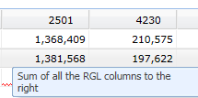
Mapping
Help and hover messages have been added prepopulated and required fields.
Expand All/Hide All – allows the user to open or hide all mapping lines with one button.
Vacancy Savings is automatically mapped to HF/GF.
Delete ALL – Will remove all mapping
Notes:
Hover help messages. Expand All – opens all mapping levels that are currently established. Hide All close all open mapping levels. Vacancy Savings is mapped to GF/HF and can only be modified if an account has both funding sources. Delete ALL – This will allow the user to delete all mapping and start over. Mapping in both fiscal years will be deleted.

Slide 105
Mapping (Cont.)
Line item - $ has been added, this will show your funding source by line item if mapped to this level.
Notes:
In the line item tab this $ has been added. Clicking on the Dollar Sign will open a pop up that shows the funding by fiscal year by revenue spource, if the account is mapped to that level. In this case Year 2 is not mapped.

Slide 106
Mapping (Cont.)
Balancing Tool
Notes:
This is a new item that has been added to allow mapping to be balanced at the Default Mapping level. When the Data Validation Edits is off by small dollar amounts, they can be adjusted in this window. This can be added at the decision unit level with the assistance of your Budget Officer.

Slide 107
Mapping (Cont.)
Position Mapping - new functionality has been added (funding crosswalks):
Notes:
Funding crosswalks provide an agency with multiple options to fund map positions. This is an added feature that is optional. To use this functionality you will need to contact your Budget Officer.
Note: Choosing copy from NEBS and PRDW will override position information on this screen. Choosing copy from default accounting will add to the existing rules, but not remove them.

Slide 108
Mapping (Cont.)
This selection allows you to view positions as they are funded in data warehouse.
Notes:
The view default accounting shows job numbers and/or accounting strings currently included in the Advantage HR system. This information can be used in the next step.

Slide 109
Mapping (Cont.)
This selection allows you to copy mapping from default accounting.
Notes:
Before choosing this selection, the View Default Acctg should be reviewed. Using this selection will not override other mapping, it will add to existing rules.

Slide 110
Questions?
Budget@finance.nv.gov
For questions after this seminar, please contact your agency’s assigned Executive Branch Budget Officer.

Slide 111
NEBS Bill Draft Request Changes
Paul Nicks
Deputy Director

Slide 112
NEBS BDR Module
BDR Concepts
Simplified BDR submittal
Easier Tracking of Requests through BDR process

Slide 113
BDR Concept Input Page

Slide 114
Budget or Policy Bill
An answer of “No” to the first question will block your ability to select Budget for BDR type, similarly an answer of “Yes” will block the Policy selections.

Slide 115
Budget or Policy Bill
If the impacts of the BDR are unknown, you will be required to provide an explanation to why the impacts cannot be determined. Designate the BDR as Policy-Substantive.

Slide 116
Concept Approval and BDR Creation
Once the concept is approved a text box will appear in the concept showing the BDR or BDRs that were created from the concept. The Governor’s office has the ability to create up to 5 BDRs from one concept and to merge a concept into an existing BDR.

Slide 117
Contact Tab Changes
The Primary contact will only need to be entered once, unless there are different contacts for BDR review and testimony.

Slide 118
Legislative BDR
Once the BDR has been approved and transmitted to the Legislative Counsel Bureau and entered into the Nevada Electronic Legislative Information System (NELIS), the Legislative BDR number will appear on the BDR in NEBS.

Slide 119
Questions?
Budget@finance.nv.gov
For questions after this seminar, please contact your agency’s assigned Executive Branch Budget Officer.

Slide 120
EITS TIN Process
David Haws
EITS Administrator

Slide 121
Technology Investment Planning TIN ORIENTATION Technical Investment Notifications
A new way for agencies to communicate to EITS about their technical initiatives

Slide 122
Vision and Goals
Improve overall IT investment visibility and collaboration.
Identify additional statewide investment opportunity.
Effective monitoring and administrating of IT investments for the State.
Provides a vital step for further strategic technology investment planning statewide.

Slide 123
History and Future
The TIR process has served the state well.
The TIN process is the natural next step.
As a questionnaire, the TIN captures overall IT investment scope and purpose and may reduce or eliminate the need for additional detailed TIR information in many instances.
TINs will be available to fill out online and provide a centralized data repository.

Slide 124
TIR vs TIN (Today vs Tomorrow)
 | TIR | TIN
What is it? | Consists of two forms: a narrative (Word file) and budgeting spreadsheet (Excel file). When filled out, provides information about a technical initiative. | A detailed online questionnaire. When filled out, provides structured information about a technical initiative.
What about it? | The TIR is not new. | The TIN is new! TINs will better track and report on technical initiatives over time.
What’s the objective? | Historical TIRS will continue to be monitored and tracked. | The TIN process will replace the TIR process as the primary means for agencies to communicate technical initiatives to EITS.

Slide 125
When should a TIN be submitted?
When the total estimated costs for a technical initiative comes to $50,000 or more, agencies need to inform EITS about it, via a TIN.
The TIN is required regardless of the funding source, including proposed software as a service (SaaS)/Cloud solutions, and even if State IT is not involved in the project or ongoing maintenance.
TINs are needed to help build up a repository of data, to help us understand the state’s overall technical profile.

Slide 126
Typical TIN process in 4 steps
Agency fills out and submits a TIN.
EITS reviews the TIN for technological opportunities for the State.
EITS notifies the agency and the Governor’s Finance Office that the TIN is completed.
EITS refers TINs that are $500K or more to the Information Technology Strategic Planning Committee (ITSPC).

Slide 127
What to expect? Process timeline
Reviews typically span three to six weeks.
The timeline may occasionally go longer, depending on the complexity of the initiative and the completeness and clarity of the TIN submission, as well as the responsiveness of the agency. Also, the timeline may be impacted by the number of TIN reviews in the EITS queue.
The good news: EITS will work with agencies to keep things moving in the process.

Slide 128
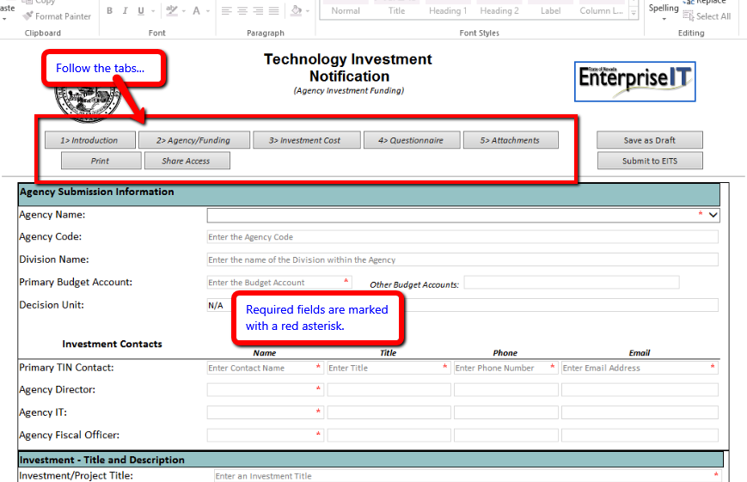
Sneak Preview

Slide 129
Sneak Preview II

Slide 130
Sneak Preview III: Capture Costs

Slide 131
Sneak Preview IV: More costs

Slide 132
Sneak Preview V

Slide 133
Sneak Preview VI: Printing

Slide 134
Sneak Preview VII: Saving to a PDF

Slide 135
Sneak Preview VIII: Attachments

Slide 136
Technical Requirements
Access to the State network
Internet Explorer 11
InfoPath filler 2010 or 2013
A user account may be needed if your agency does not use EITS email.
Communicate to EITS who needs to access TINS at your agency and we can help with account set up.

Slide 137
Help needed?
EITS orientation meetings will be conducted.
Orientation materials will be available for download.
Email the TIN Admin with questions: TIAdmin@admin.nv.gov

Slide 138
Key dates for this budget cycle
Action item | Owner | Deadline | Notes
TINs due to EITS. | Agencies | April 6 2018
TINs due to IT Strategic Planning Committee (ITSPC). | EITS/Agency | June 15 2018 | The ITSPC committee reviews and ranks TINS that are $500K and above.
ITPSC sends TIN priority list to the Governor’s Finance Office. | ITSPC - EITS | July 11 2018

Slide 139
Reminder
TINs are also required for interim year initiatives.

Slide 140
The End. Thank you!
Q and A

Slide 141
Thank You!

